Slide 1



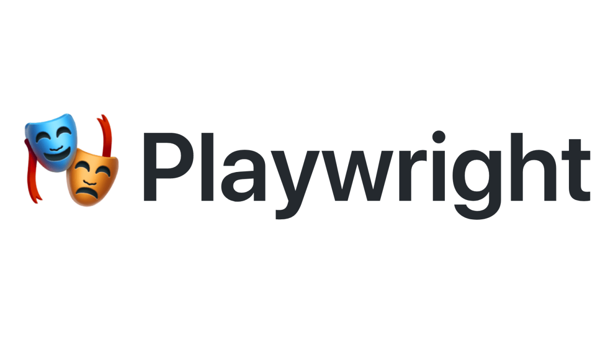
Learning PlayWright (Java)
Pramod Dutta
SDET Manager
E2E Web Testing with Playwright(Java) - Part 1

Slide 2
Why You should learn Playwright?
If you want to enhance the Automation Knowledge.
QA Fresher to enhance Skills
Use Playwright for UI Automation.
Easy to use and Cross browser Tool
Easy to integrate with other Test frameworks
Knowledge of Java is required. (If not You can manage)

Slide 3
Agenda
Introduction to Playwright
Why Playwright
About Playwright
Automate a Quick Test case.

Slide 4
Playwright Introduction.
Playwright means a person who write Plays

Slide 5
What is Playwright?
Playwright Enables reliable end-to-end testing for modern web apps.
Modern Web Apps are higher user expectations and greater demands.
Cloud-hosted and scalable
SPA behaviors supported
Modular and loosely coupled
Most of the work done at backend.
https://docs.microsoft.com/en-us/dotnet/architecture/modern-web-apps-azure/modern-web-applications-characteristics
Example - https://paytm.com/ - SPA

Slide 6
What is Playwright?
SPA - Web application or website that interacts with the user by dynamically rewriting the current web page with new data from the web server.
Most of the Modern Browsers relies on rendering engines.
Blink — used in Chromium-based browsers like Google Chrome, modern Opera and Microsoft Edge
Gecko — used in Firefox and other Mozilla projects
Webkit — nowadays used by Safari browser for desktop and mobile platforms

Slide 7
What is Playwright?
Playwright provides single APIs.
Playwright is Node.js library able to launch Blink, Gecko and WebKit engines, giving everything Selenium can do and additionally providing all important features not available in Selenium and described above.
Selenium lacks in ability
to catch any page lifecycle events, log messages and exceptions being thrown.
inspect and optionally mock all network requests between client and server side

Slide 8
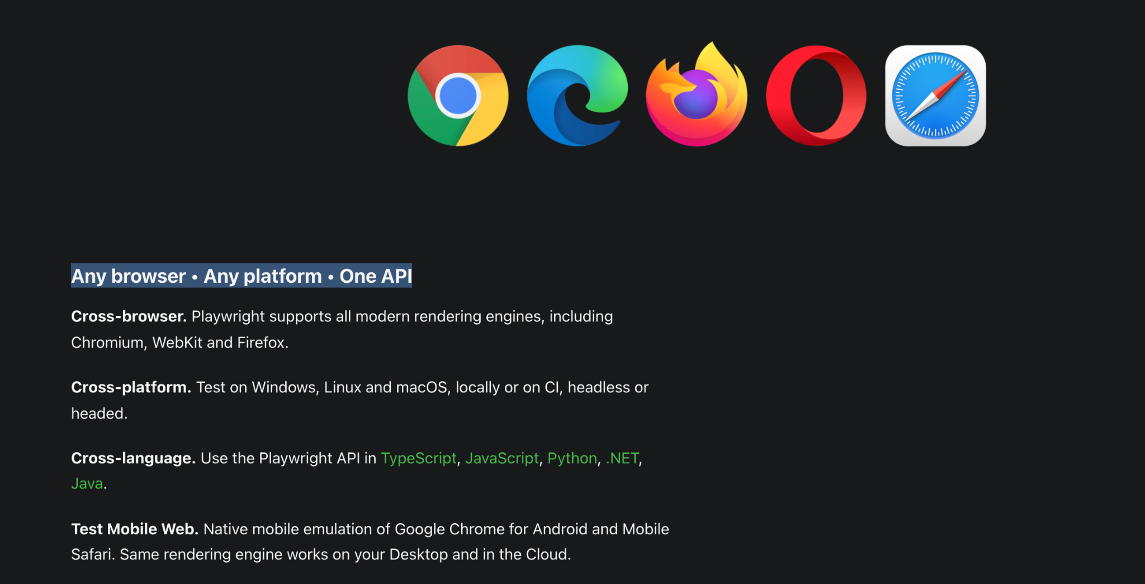
What is Playwright?

Slide 9
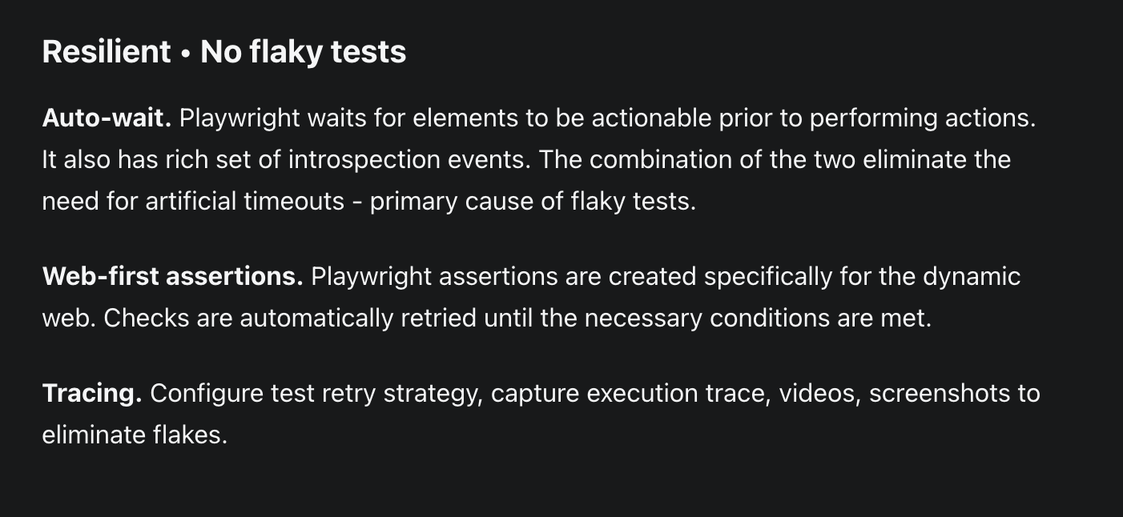
What is Playwright?

Slide 10
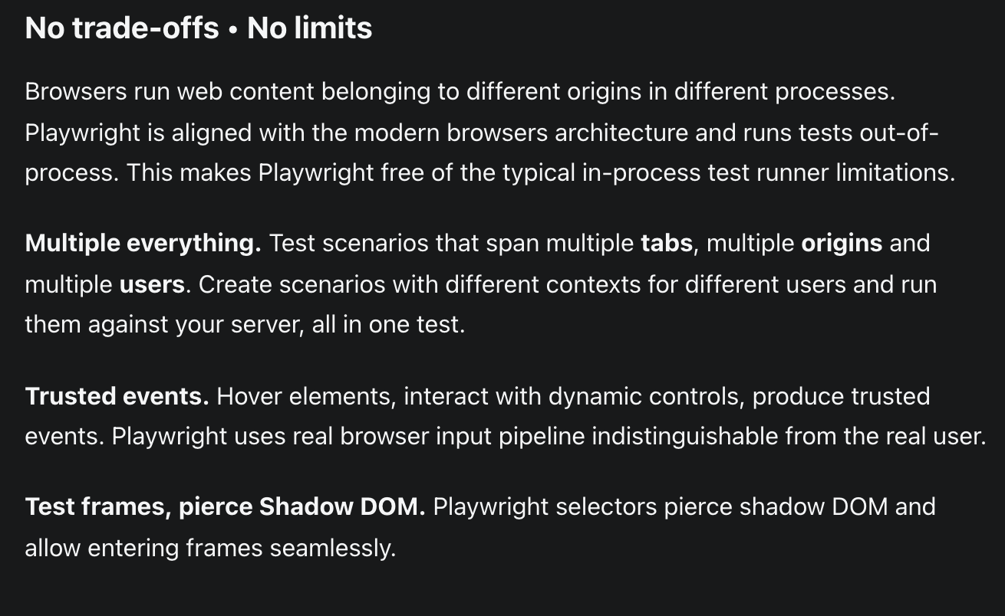
What is Playwright?

Slide 11
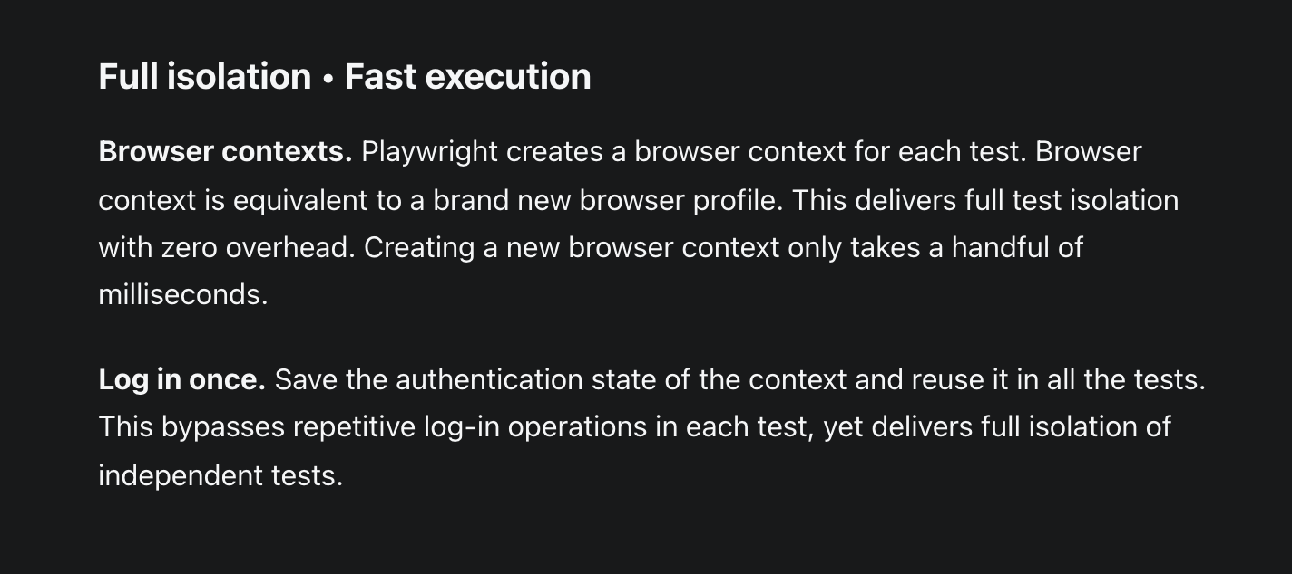
What is Playwright?

Slide 12
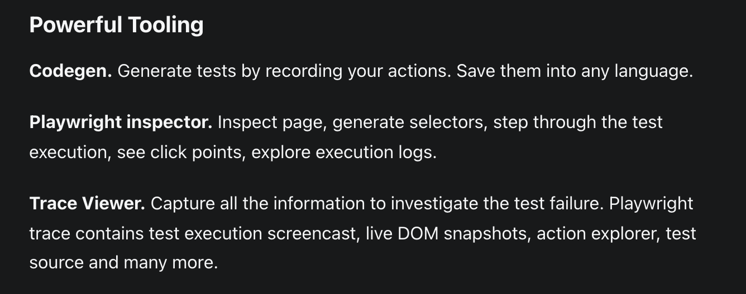
What is Playwright?

Slide 13
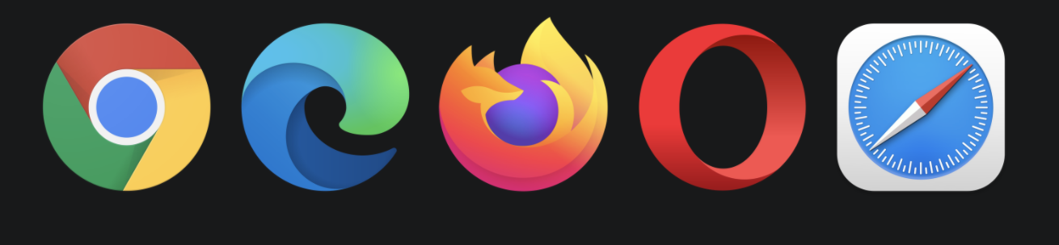
Why Playwright?
https://playwright.dev/docs/why-playwright
Support for all browsers​
Fast and reliable execution​
Auto-wait APIs
Powerful automation capabilities​
multiple pages.

Slide 14
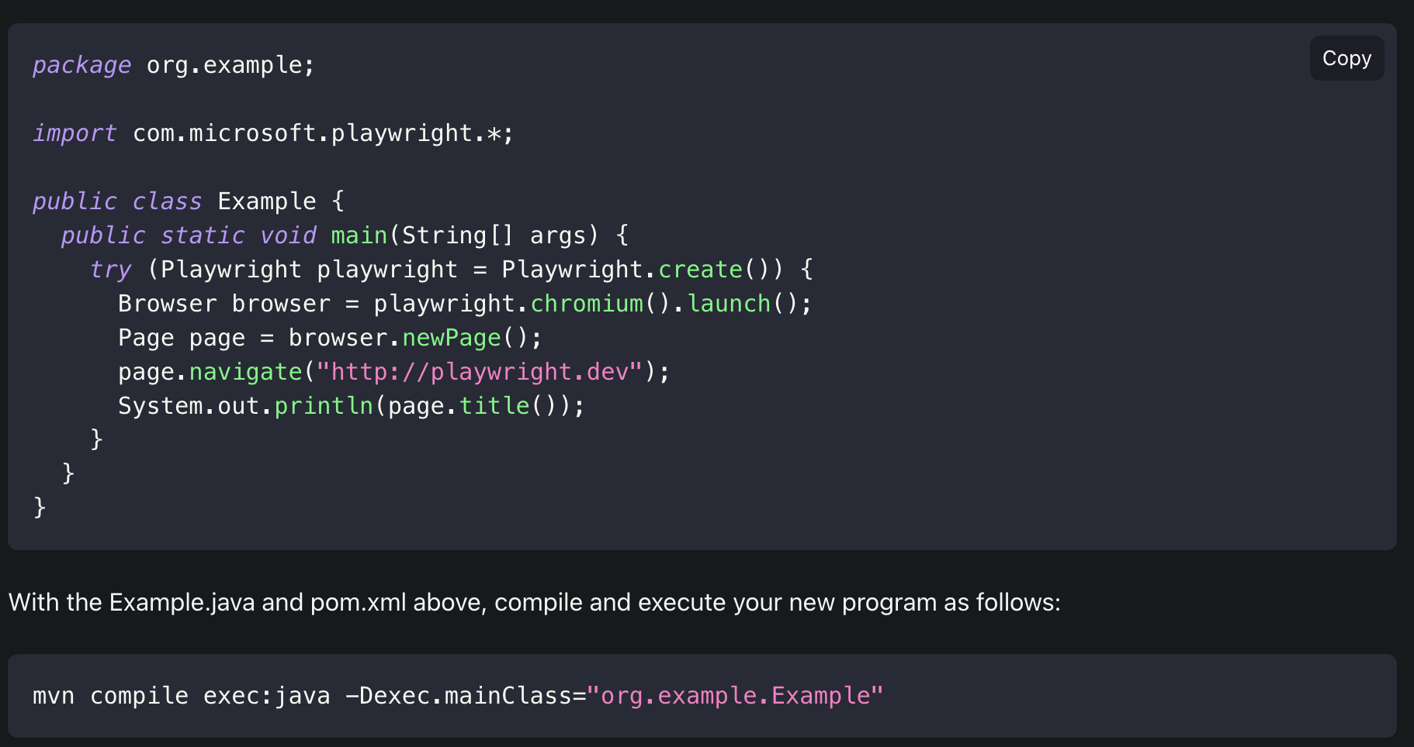
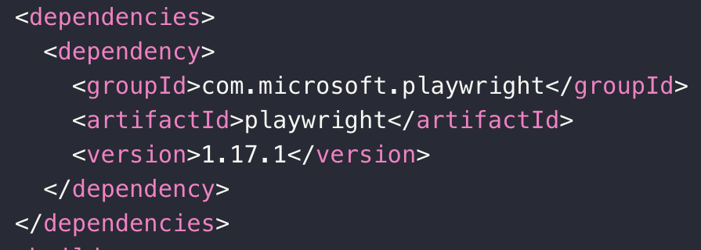
Running Simple Tes
Installation

Slide 15
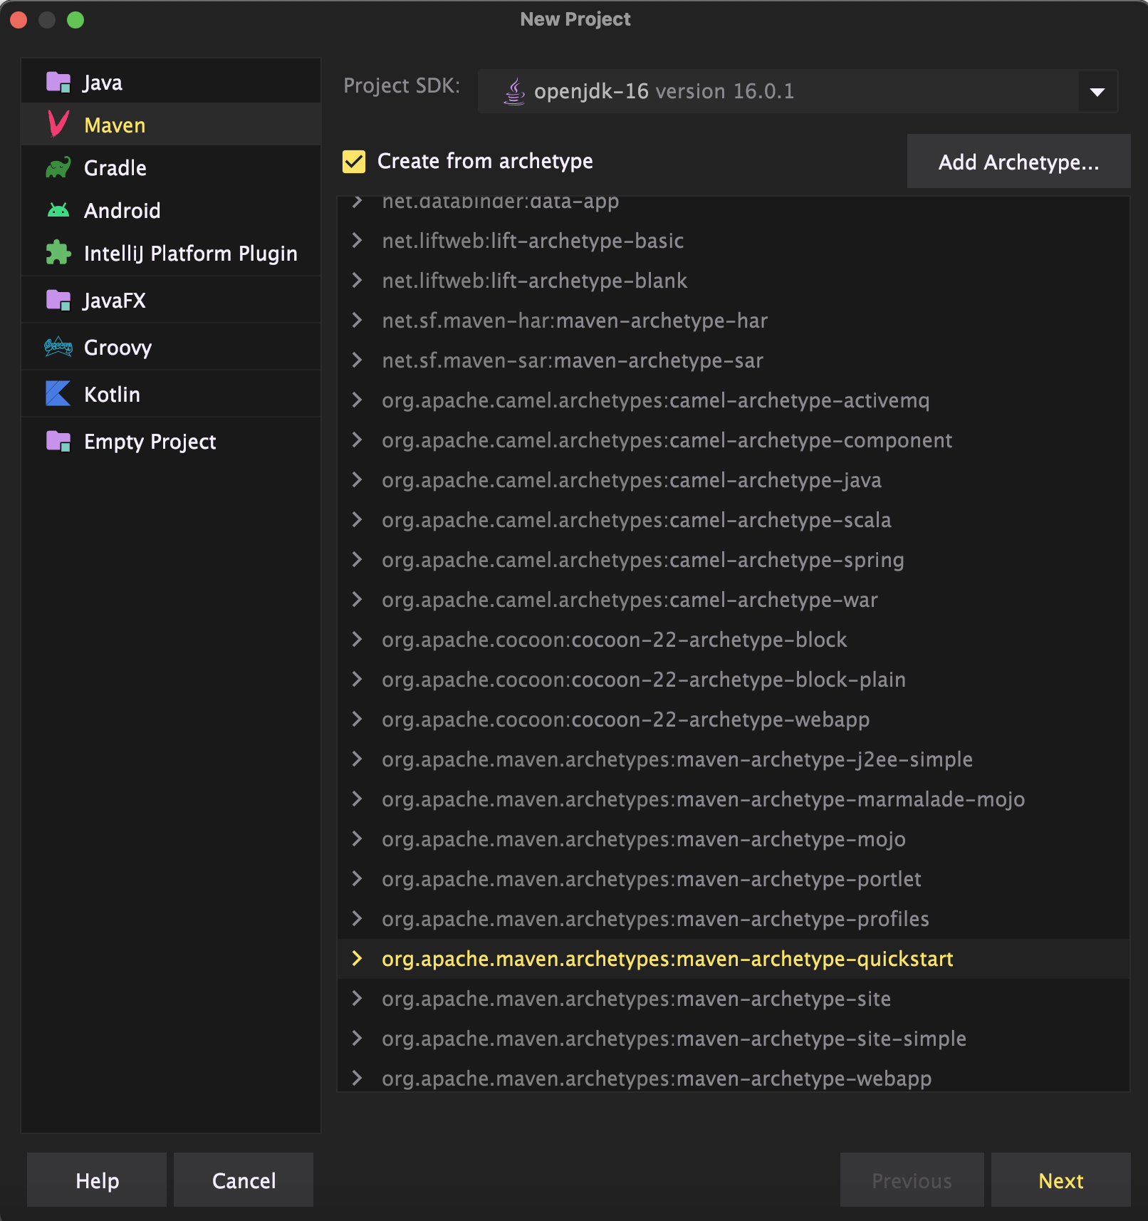
Running Simple Tes
Installation

